Slide 1
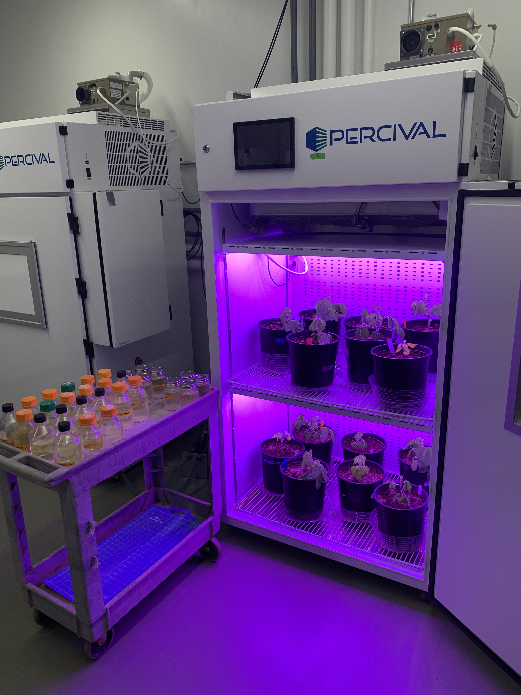

Nitrogen supply and demand control plant responses to elevated CO₂ at difference scales
Evan A. Perkowski
Ezinwanne Ezekannagha
Nicholas G. Smith

Slide 2
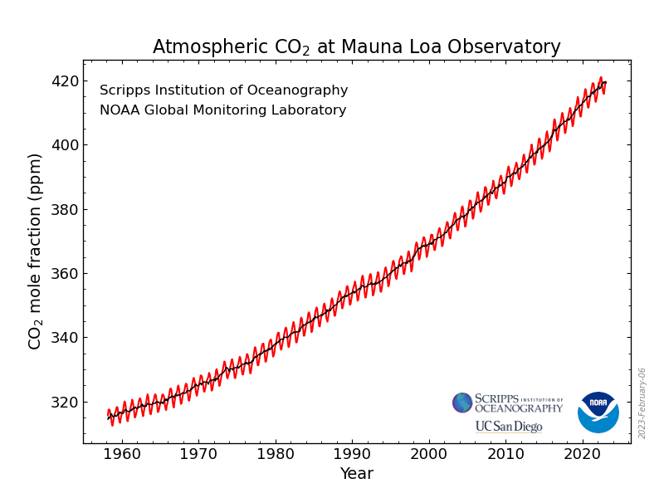
https://gml.noaa.gov/ccgg/trends/

Slide 3
33% increase in CO₂ concentration since 1960
61% of this increase has occurred since 1990
https://gml.noaa.gov/ccgg/trends/

Slide 4
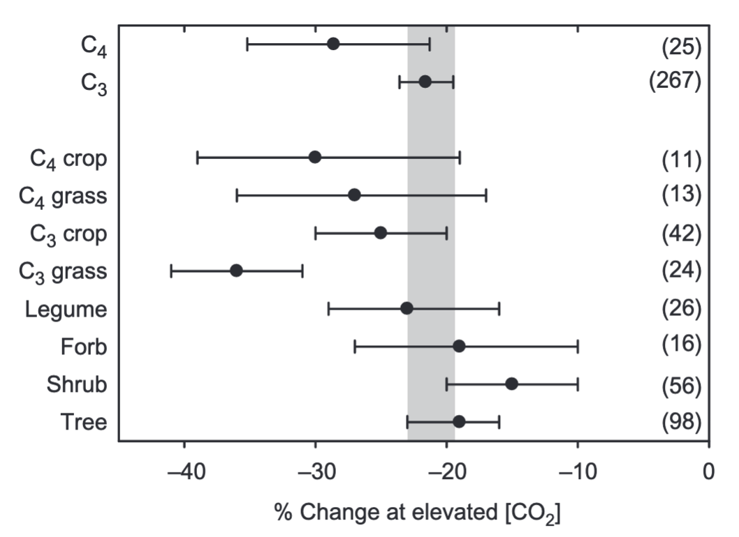
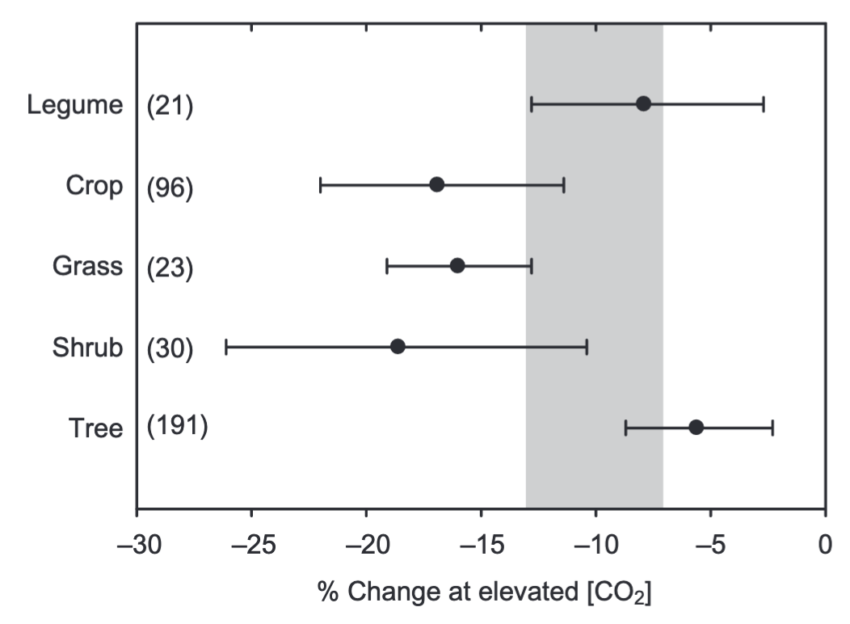
Plants grown under elevated CO₂ exhibit reductions in stomatal conductance and photosynthetic capacity
Stomatal conductance
Photosynthetic capacity
Ainsworth & Rogers (2007) PC&E

Slide 5
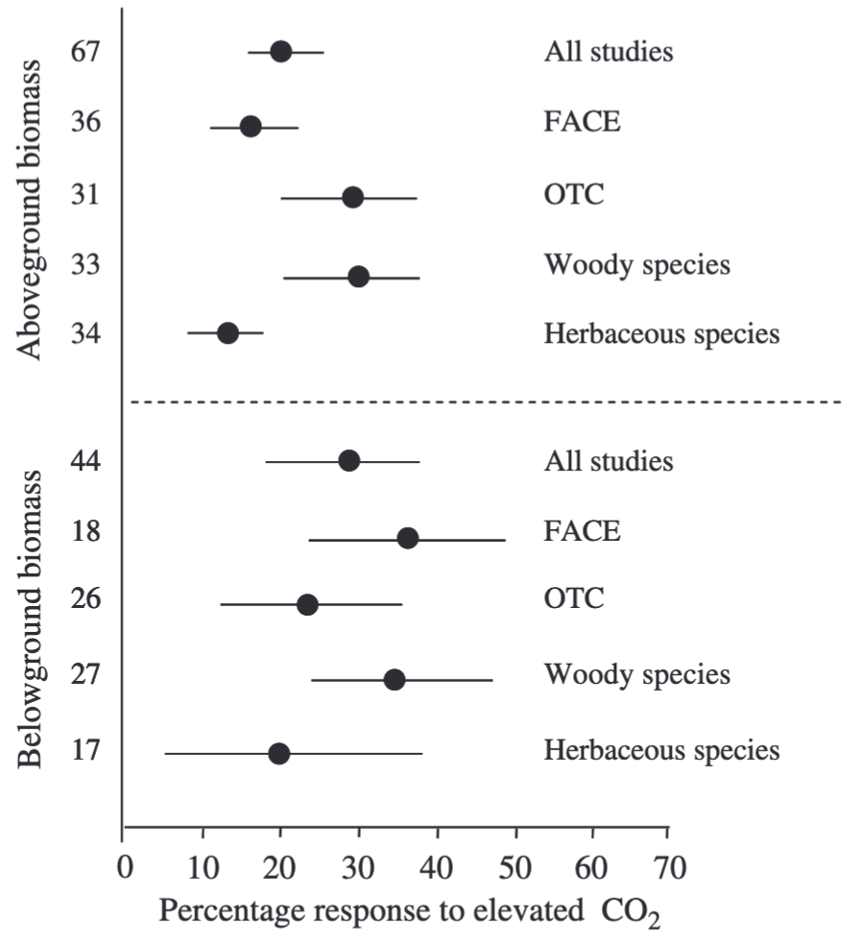
Leaf responses to elevated CO₂ correspond with increased whole-plant growth
Aboveground biomass
Belowground biomass
de Graaf et al. (2006) Global Change Biology

Slide 6
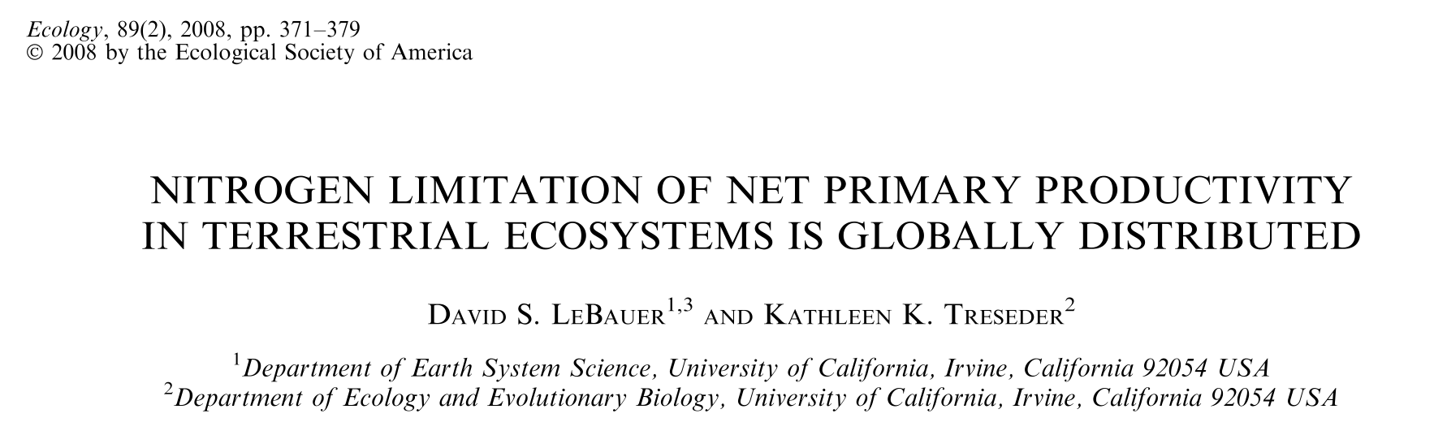
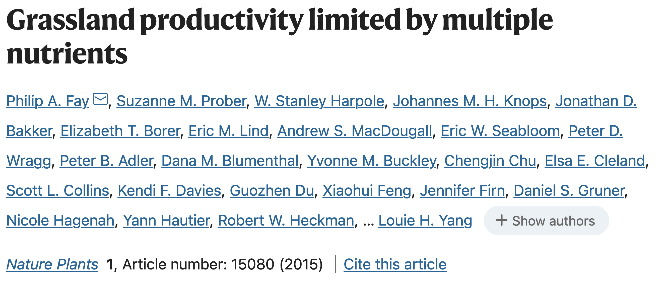
As nutrient availability commonly limits net primary productivity…
LeBauer & Treseder (2008) Ecology; Fay et al. (2015) Nature Plants

Slide 7
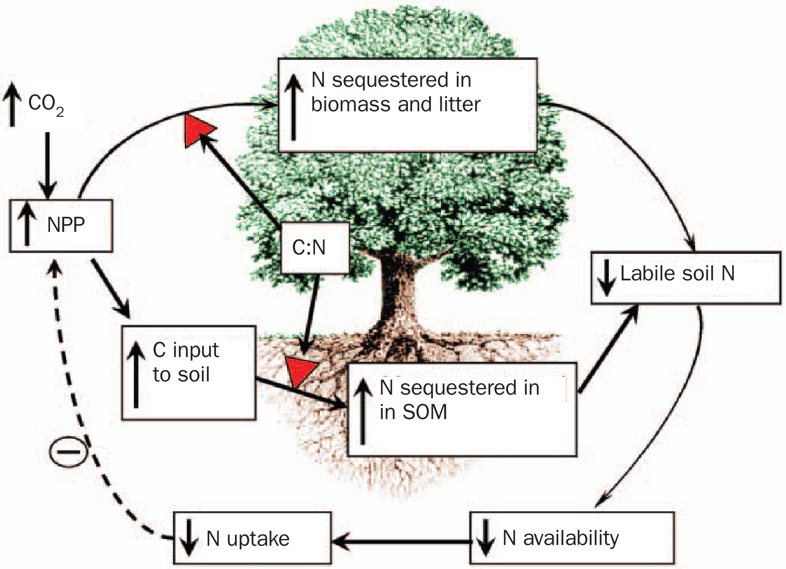
Nutrient limitation has been hypothesized to be the primary mechanism driving plant responses to CO₂
Luo et al. (2004) BioScience
Notes:
As nutrients commonly limit primary productivity globally, progressive nutrient limitation has been hypothesized…

Slide 8
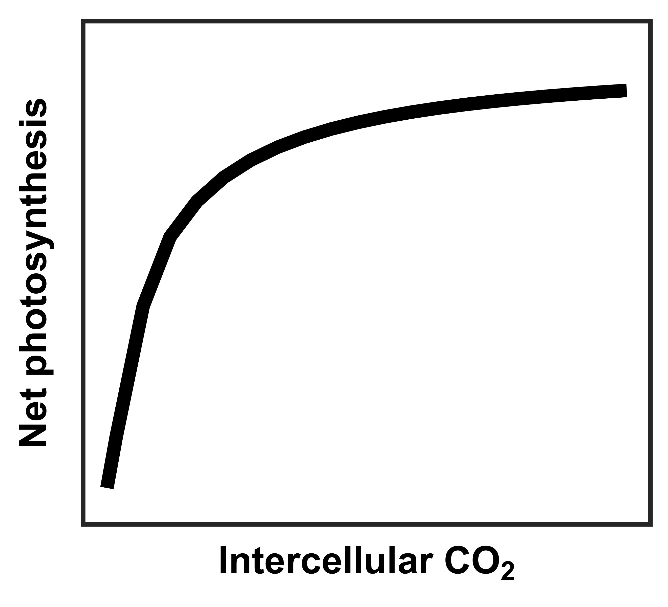
However, an alternative hypothesis suggests that plant demand to build and maintain photosynthetic enzymes drives the leaf response to CO₂
Figure adapted from Moore et al. (1999) PC&E

Slide 9
However, an alternative hypothesis suggests that plant demand to build and maintain photosynthetic enzymes drives the leaf response to CO₂
RuBP-limited photosynthesis
(A_{j})
Rubisco-limited photosynthesis
(A_{c})
Figure adapted from Moore et al. (1999) PC&E
Notes:
As intercellular CO2 concentrations increase, leaves become saturated with CO2 substrate.
Thus, net photosynthesis rates begin to become limited by how quickly RuBP regenerates, which is a function of light availability
Rubisco is nitrogen-rich and therefore nutritionally expensive to build and maintain​

Slide 10
However, an alternative hypothesis suggests that plant demand to build and maintain photosynthetic enzymes drives the leaf response to CO₂
RuBP-limited photosynthesis
(A_{j})
Rubisco-limited photosynthesis
(A_{c})
A_{c} = A_{j}
Figure adapted from Moore et al. (1999) PC&E
Notes:
Therefore, plants may strive to optimally allocate nitrogen to Rubisco to maximize nitrogen allocation to other structures and functions
such that
operational net photosynthesis rates are equally limited by Rubisco- and RuBP-limited photosynthesis rates (Ac = Aj)​
Operational net photosynthesis rate here indicates the net photosynthesis rate of a plant growing under its acclimated growing conditions

Slide 11
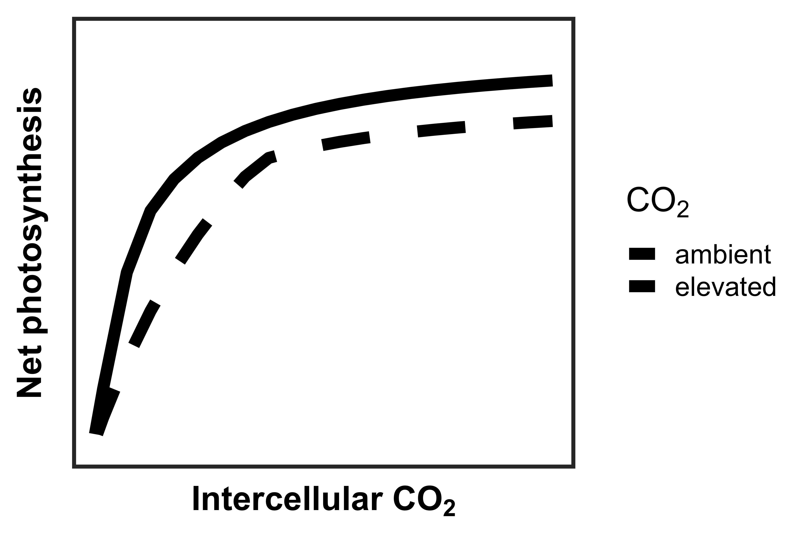
However, an alternative hypothesis suggests that plant demand to build and maintain photosynthetic enzymes drives the leaf response to CO₂
RuBP-limited photosynthesis
(A_{j})
Rubisco-limited photosynthesis
(A_{c})
A_{c} = A_{j}
Figure adapted from Moore et al. (1999) PC&E
Notes:
We expect these same optimal resource investments to occur under elevated CO2, but notice that the curve looks a bit different
The reduced initial slope extends the portion of the curve that is limited by Rubisco carboxylation and CO2,
increasing the operational photosynthesis rate and the intercellular CO2 threshold where Rubisco limited photosynthesis equals RuBP limited photosynthesis
This results in a stronger decrease in Rubisco-limited photosynthesis than RuBP-limited​ photosynthesis to achieve Ac = Aj

Slide 12
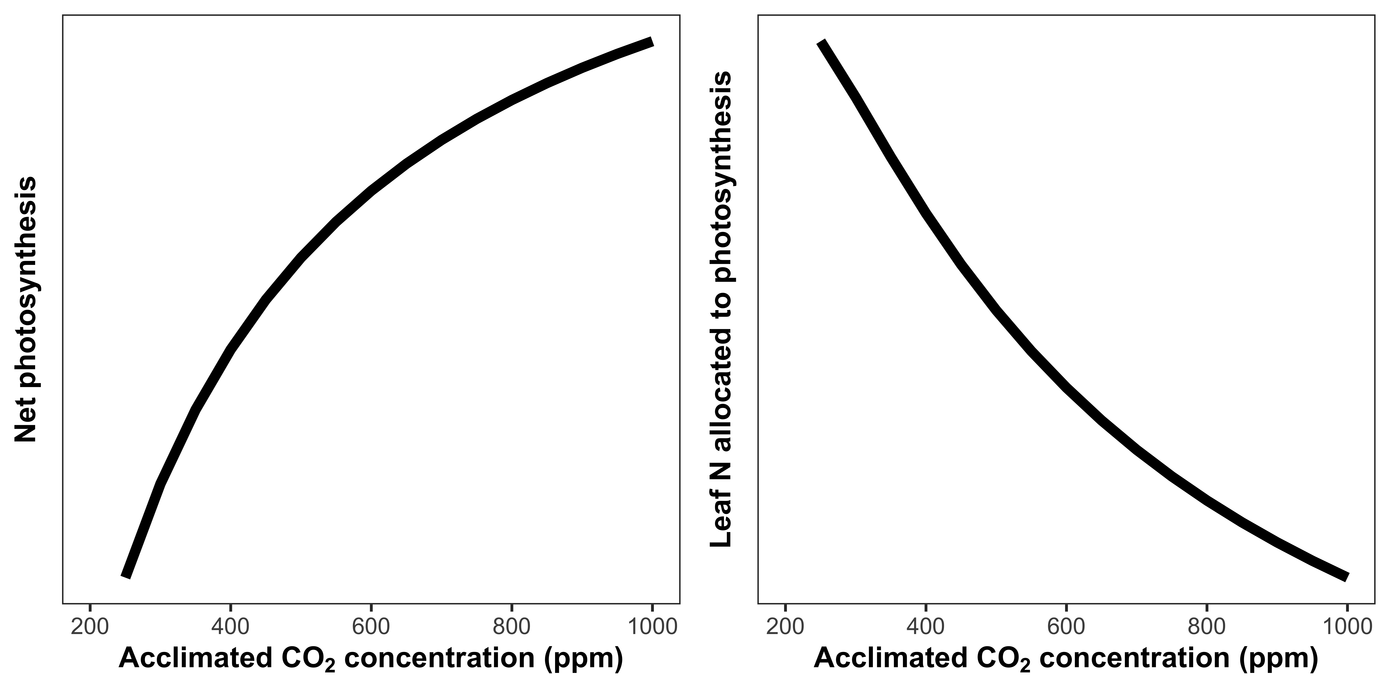
Optimal resource investment to photosynthetic enzymes increases leaf photosynthesis at lower nutrient use
Notes:
As another example to illustrate this…

Slide 13
Optimal resource investment to photosynthetic enzymes increases leaf photosynthesis at lower nutrient use
Increased net photosynthesis
rate
Notes:
Let’s say we measure two plants, one acclimated under ambient CO2 concentrations and one at 800 ppm CO2

Slide 14
Optimal resource investment to photosynthetic enzymes increases leaf photosynthesis at lower nutrient use
Reduced nutrient allocation to photosynthetic enzymes
Increased net photosynthesis
rate
Notes:
Optimal resource investment suggests that this response should increase operational net photosynthesis rates with reduced nitrogen investment into enzymes that support net photosynthesis

Slide 15
Study Question
How does soil nitrogen availability modify leaf and whole plant responses to CO₂?

Slide 16
Nitrogen limitation
hypothesis
eCO₂
Photosynthetic capacity
Soil N supply
Whole-plant growth
= net positive effect
= net negative effect
= null effect

Slide 17
Nitrogen limitation
hypothesis
Optimality
hypothesis
eCO₂
Photosynthetic capacity
eCO₂
Photosynthetic capacity
Soil N supply
Whole-plant growth
Soil N supply
Whole-plant growth
= net positive effect
= net negative effect
= null effect

Slide 18
Experiment setup
Acquisition strategy
Soil N treatments
0 ppm N
+ BNF
35 ppm N
- BNF
70 ppm N
105 ppm N
CO₂ treatments
140 ppm N
210 ppm N
ambient (420 ppm)
280 ppm N
elevated (1000 ppm)
350 ppm N
630 ppm N
Perkowski et al. (in prep)

Slide 19
Experiment setup
Acquisition strategy
Soil N treatments
0 ppm N
+ BNF
35 ppm N
- BNF
70 ppm N
105 ppm N
CO₂ treatments
140 ppm N
210 ppm N
ambient (420 ppm)
280 ppm N
elevated (1000 ppm)
350 ppm N
630 ppm N
Perkowski et al. (in prep)

Slide 20
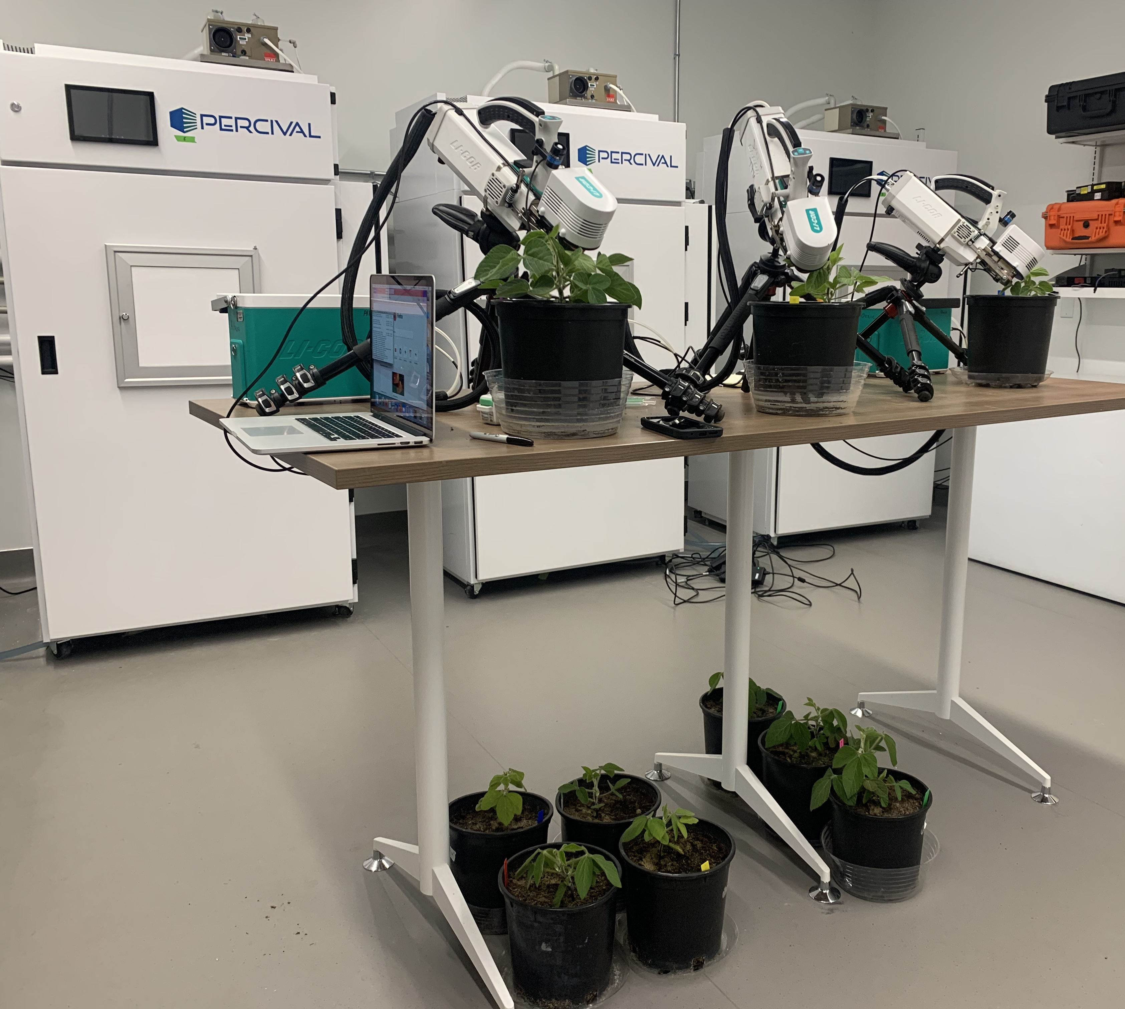
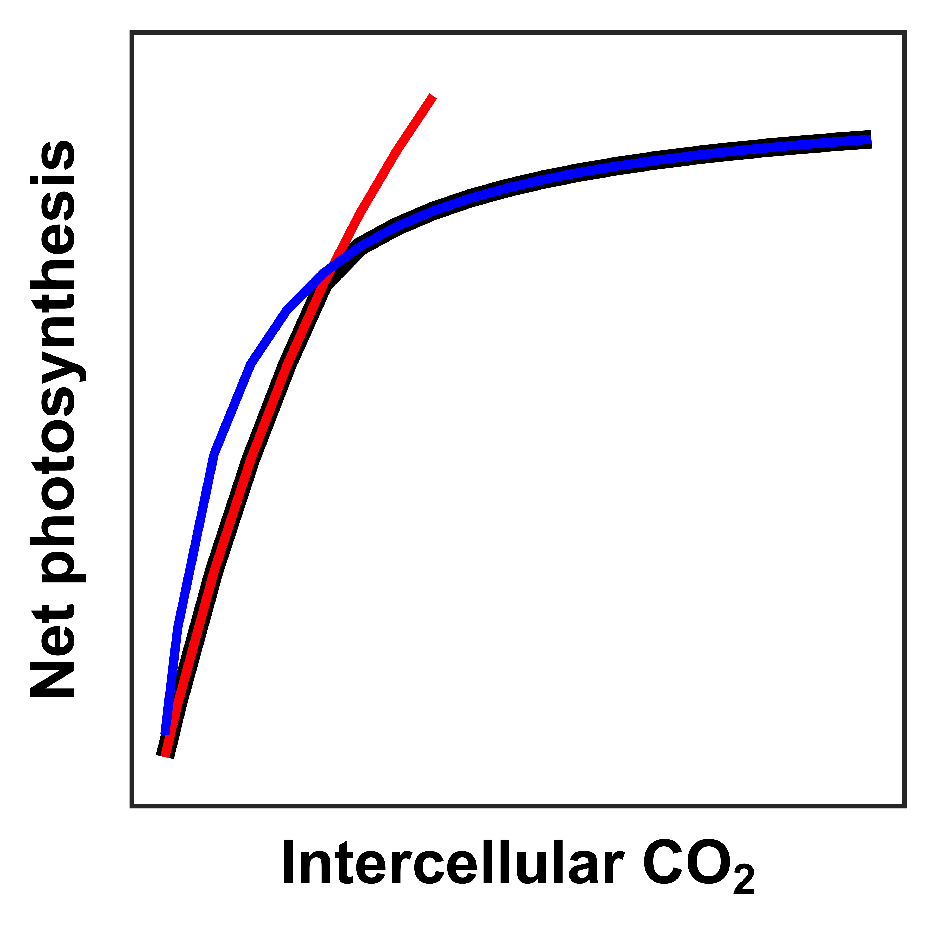
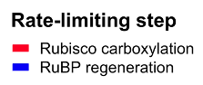
Measurements
Leaf trait
Leaf biochemistry (V_{cmax25}, J_{max25}, J_{max25}:V_{cmax25})
Total leaf area, total biomass
Structural carbon cost to acquire nitrogen
Perkowski et al. (in prep)

Slide 21
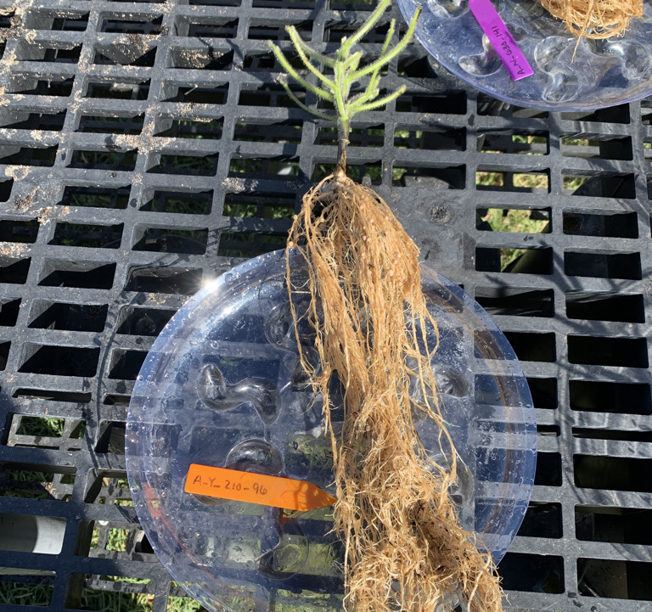
Measurements
Leaf trait
Whole plant trait
Leaf biochemistry (V_{cmax25}, J_{max25}, J_{max25}:V_{cmax25})
Total leaf area, total biomass
Carbon cost to acquire nitrogen
Perkowski et al. (in prep)

Slide 22
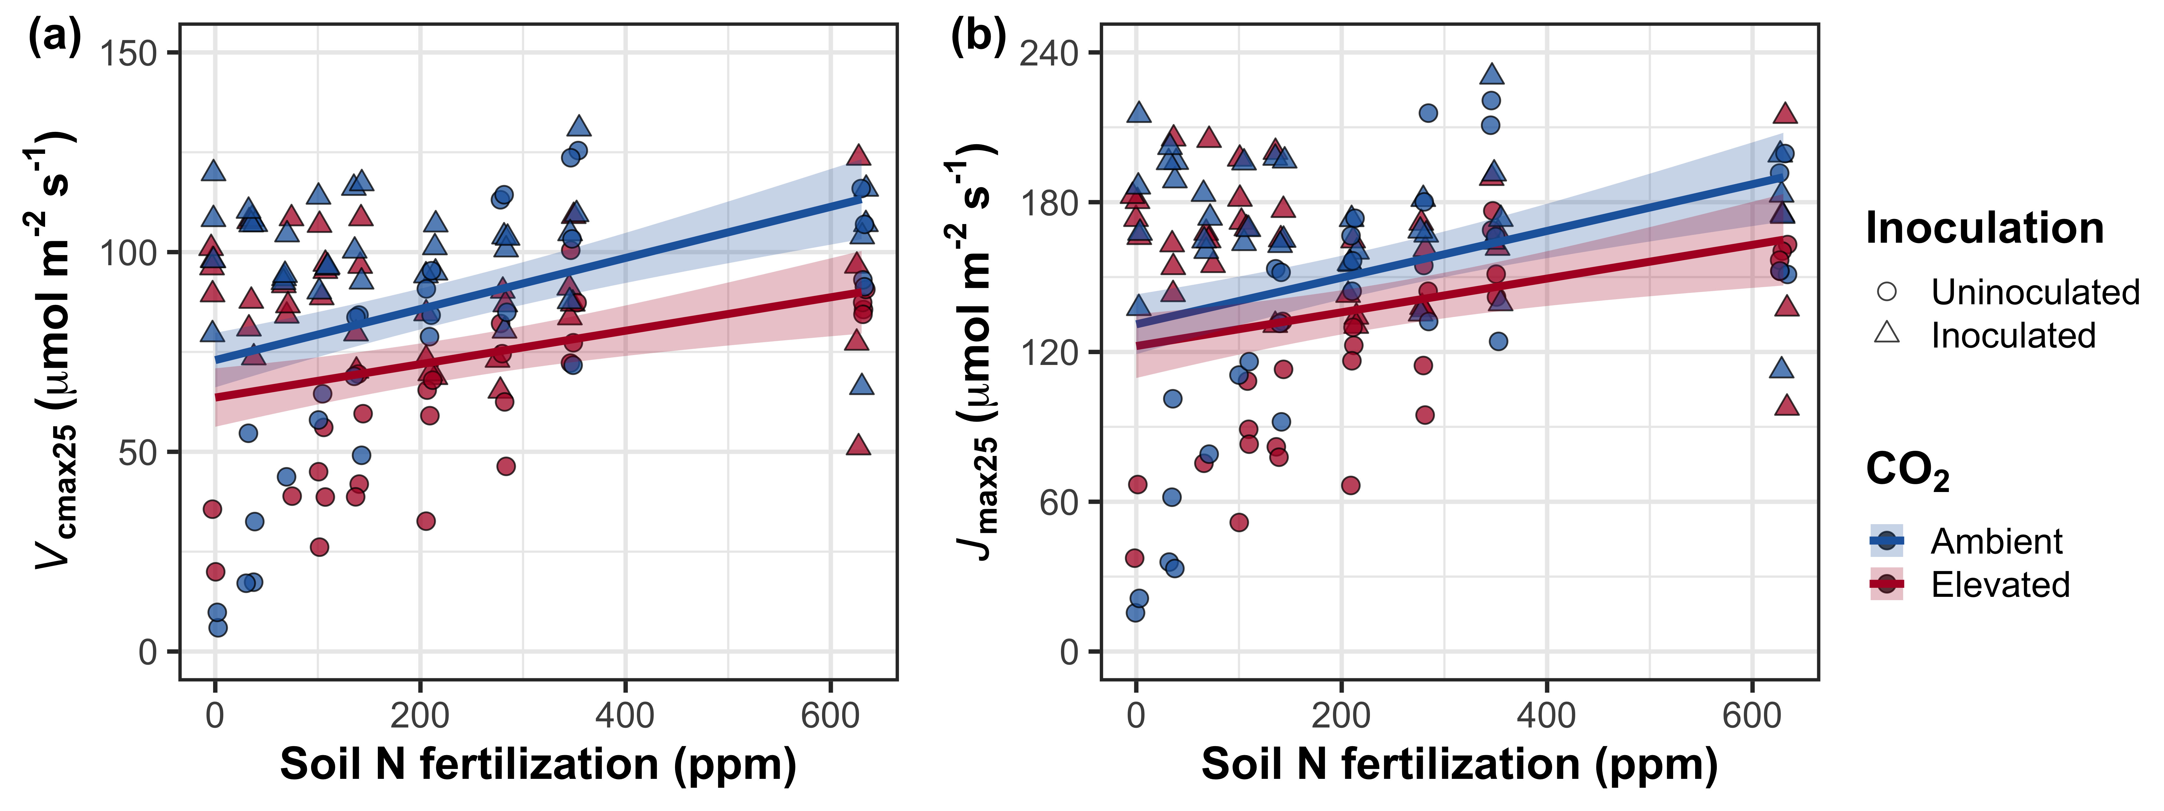
Elevated CO₂ decreased photosynthetic capacity independent of fertilization
CO₂: | p<0.001
N: | p<0.001
CO₂*N: | NS
Notes:
Elevated CO2 reduced leaf biochemical process rates
Soil nitrogen fertilization generally increased leaf biochemical process rates, but the slope of this relationship was similar between both CO2 treatments
Indicates that the reduction in photosynthetic capacity under elevated CO2 was independent of fertilization

Slide 23
Elevated CO₂ decreased photosynthetic capacity independent of fertilization
CO₂: | p<0.001
N: | p<0.001
CO₂*N: | NS
CO₂: | p=0.014
N: | p<0.001
CO₂*N: | NS
Notes:
Elevated CO2 reduced leaf biochemical process rates
Soil nitrogen fertilization generally increased leaf biochemical process rates, but the slope of this relationship was similar between both CO2 treatments
Indicates that the reduction in photosynthetic capacity under elevated CO2 was independent of fertilization

Slide 24
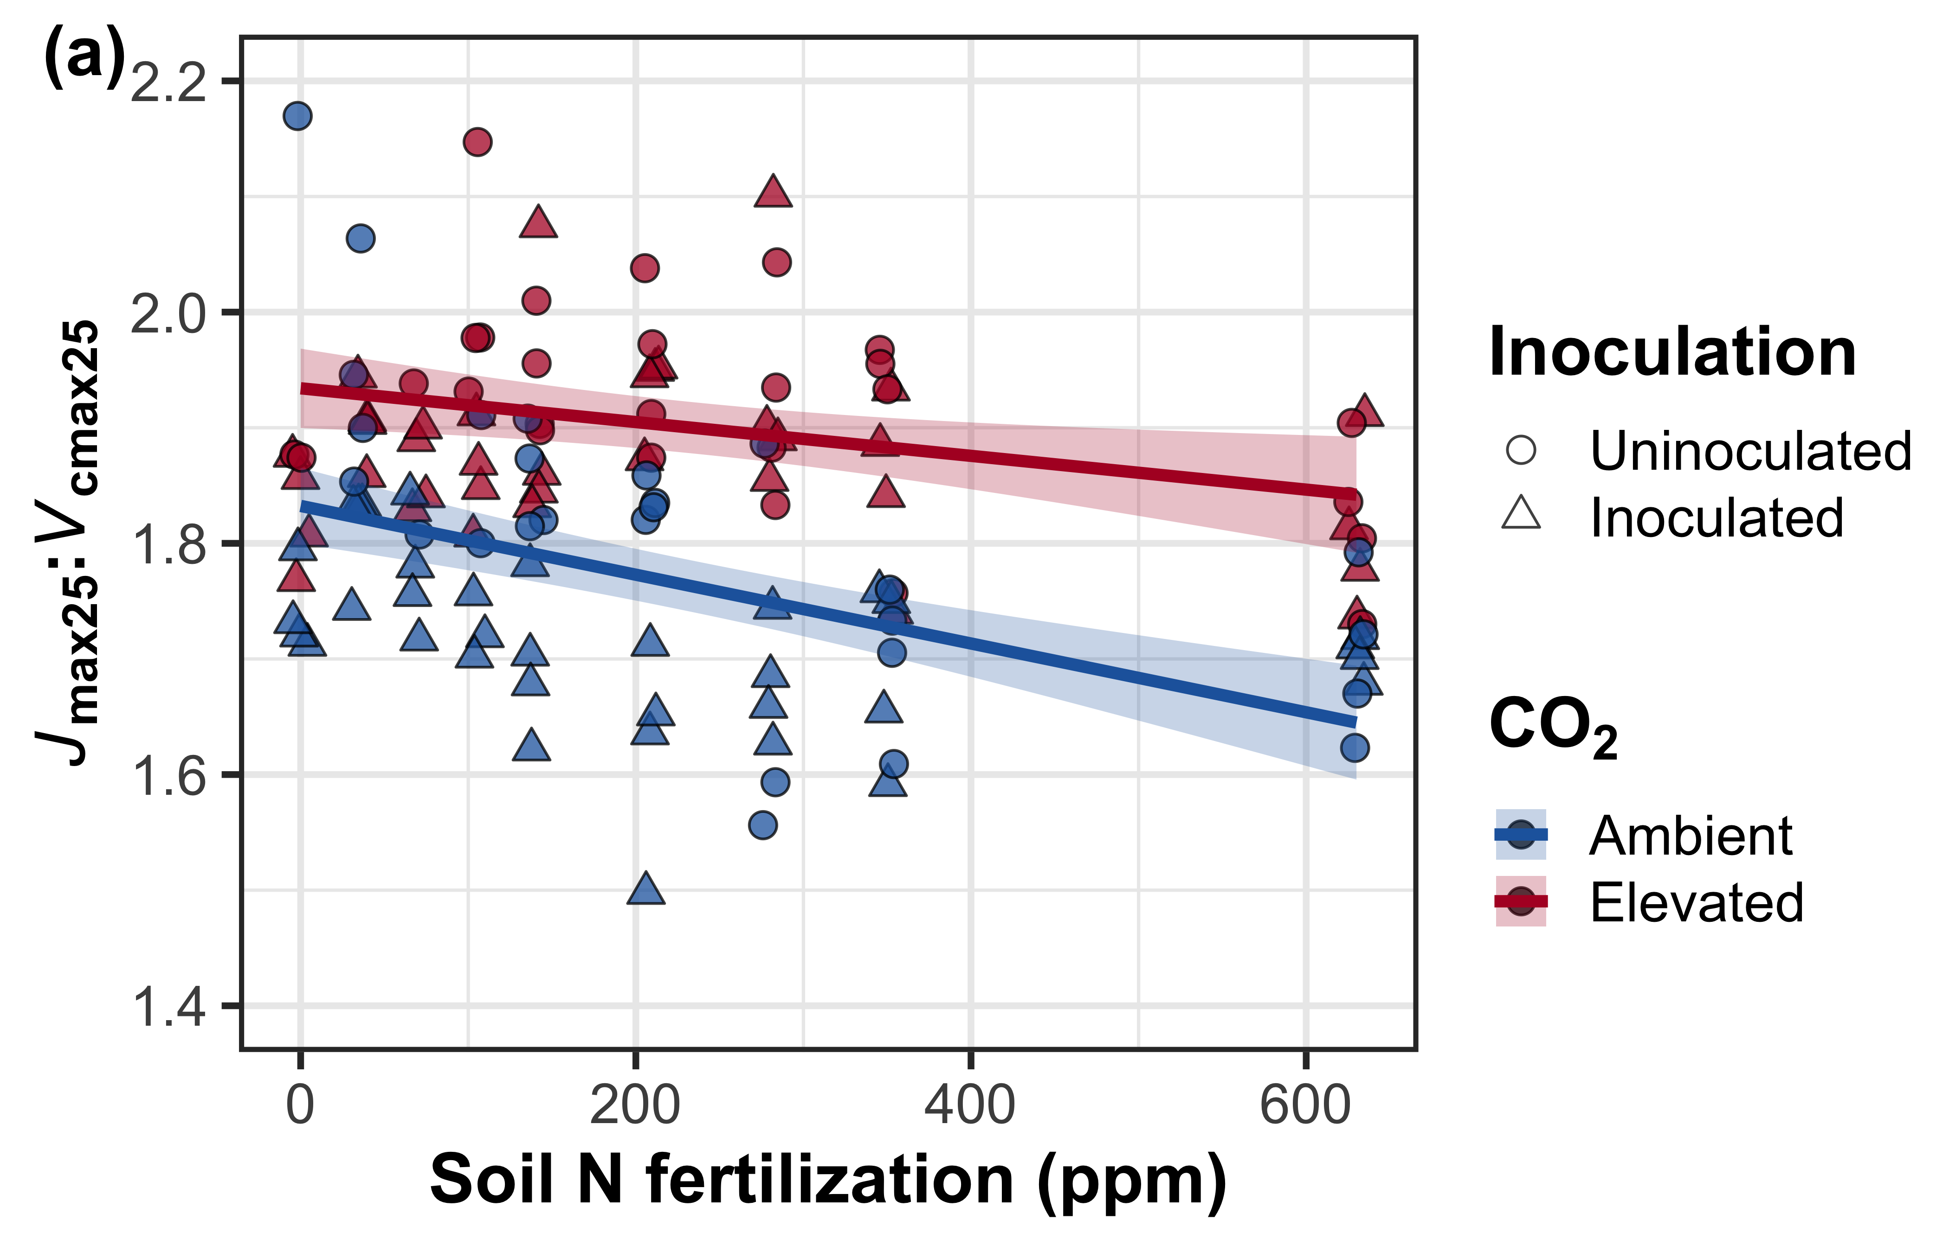
Elevated CO₂ decreased V_{cmax25} more strongly than J_{max25}, again independent of fertilization
CO₂: | p<0.001
N: | p<0.001
CO₂*N: | NS
Notes:
Optimal resource investment = stronger downregulation in Vcmax than Jmax

Slide 25
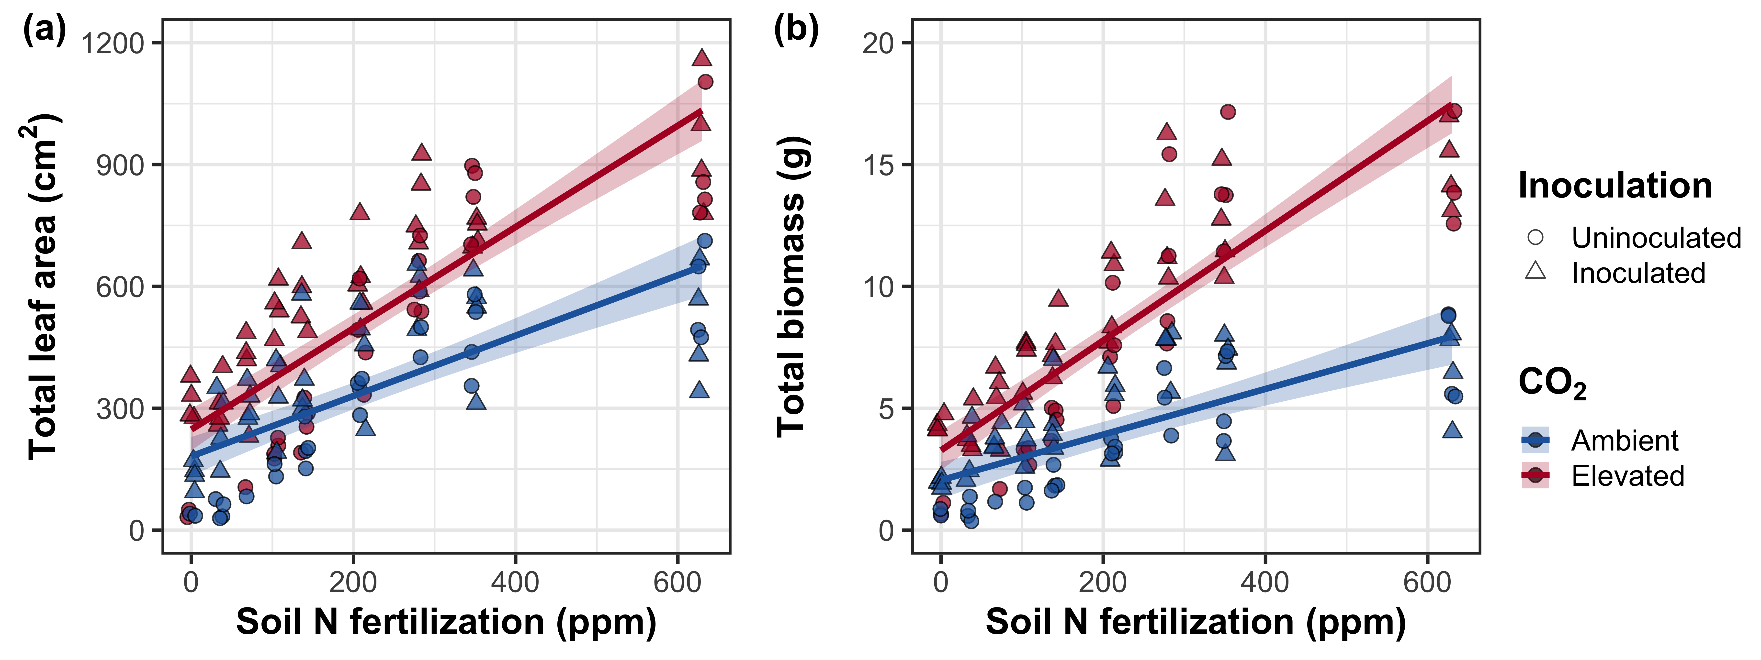
Increasing fertilization increased the positive effect of elevated CO₂ on whole-plant growth
CO₂: | p<0.001
N: | p<0.001
CO₂*N: | p<0.001
CO₂: | p<0.001
N: | p<0.001
CO₂*N: | p<0.001
Perkowski et al. (in prep)
Notes:
Despite reductions in photosynthetic capacity and leaf nitrogen allocation at the leaf level, I observe strong stimulations in whole plant growth under elevated CO2

Slide 26
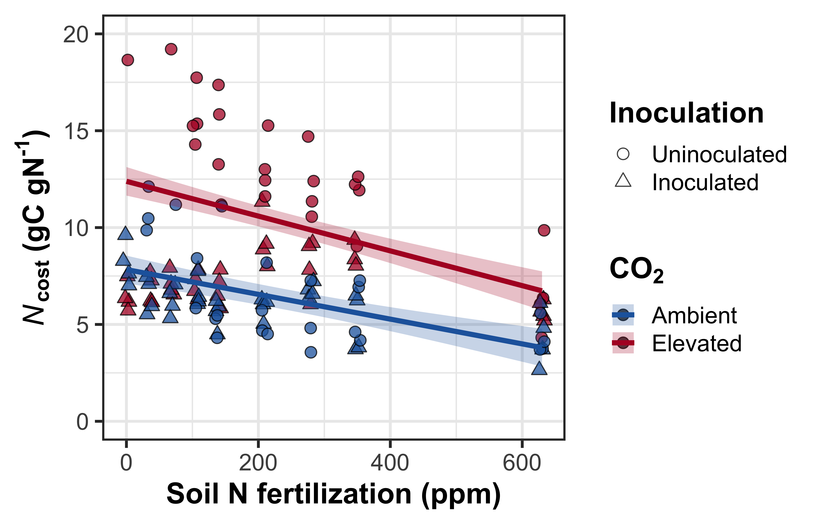
Increasing fertilization decreased costs of nitrogen acquisition similarly across the two CO₂ treatments
CO₂: | p<0.001
N: | p<0.001
CO₂*N: | NS
Perkowski et al. (in prep)

Slide 27
Conclusions
Nitrogen demand and supply control plant responses to eCO₂ at different scales
N supply → whole-plant response to eCO₂
N demand → leaf response to eCO₂
eCO₂
Photosynthetic capacity
Soil N supply
Whole-plant growth

Slide 28
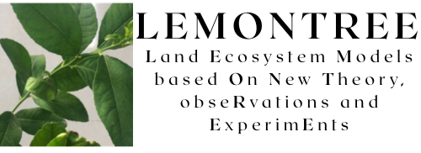


Acknowledgements
Mylea Lovell (TTU IGCAST Phytotron manager)
University of California-Davis Stable Isotope Facility
EcoHealth Lab at Texas Tech University
Brad Posch
Alissar Cheaib
Eve Gray
Monika Kelley
Isa Beltran
Snehanjana Chatterjee

Slide 29
Thank you!

Slide 30
Extra slides

Slide 31
Soil N fertilization only influences leaf biochemical process rates in uninoculated pots
Perkowski et al. (in prep)

Slide 32
Inoculation reduced the negative effect of increasing fertilization on costs to acquire nitrogen
Perkowski et al. (in prep)

Slide 33
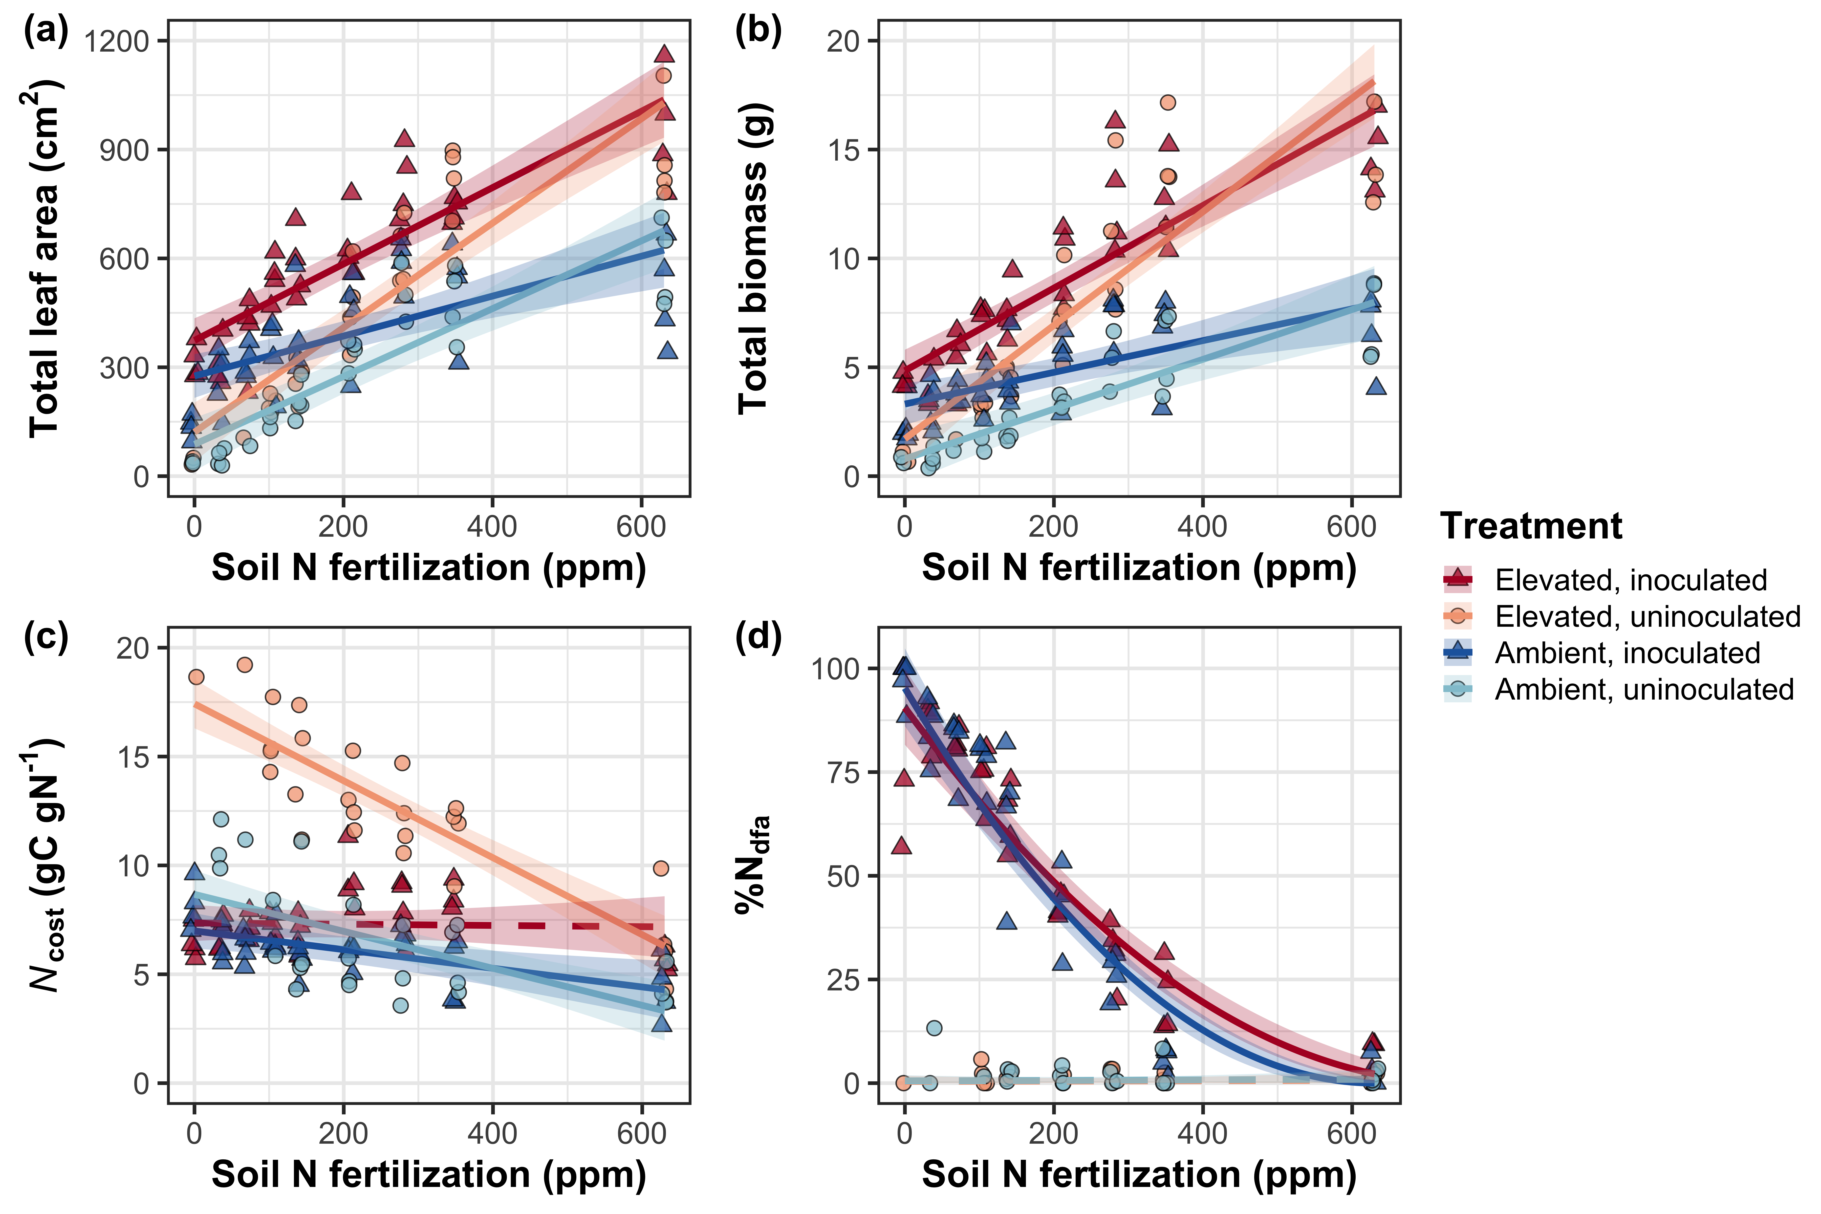
Plants reduce investment in nitrogen fixation with increasing fertilization
Perkowski et al. (in prep)

